Slide 1

Tableau

Slide 2
Quick Overview
NEO WORKFLOW
Introduction to Tableau
What is Data Visualization
Basic Concepts in Tableau
How does Tableau work?
Tableau Demo
Types of Connections - Demo
What is Tableau
Why Tableau
Tableau Products and Similar Products
Calculated Fields
Types of Connections
Filters
Sets
Grouping/Hierarchy
Parameter
Windows Function/Table Calculation
Dual Axis
Data Blending
Tableau Server
Calculated Fields - Demo
Filters - Demo
Sets - Demo
Grouping/Hierarchy - Demo
Parameter - Demo
Windows Function/Table Calculation - Demo
Dual Axis - Demo
Data Blending - Demo
Tableau Server - Demo
Dimensions vs Measures

Slide 3
Introduction to Tableau
What is Data Visualisation -
Data visualization is a general term that describes any effort to help people understand the significance of data by placing it in a visual context. Patterns, trends and correlations that might go undetected in text-based data can be exposed and recognized easier with data visualization software.

Slide 4
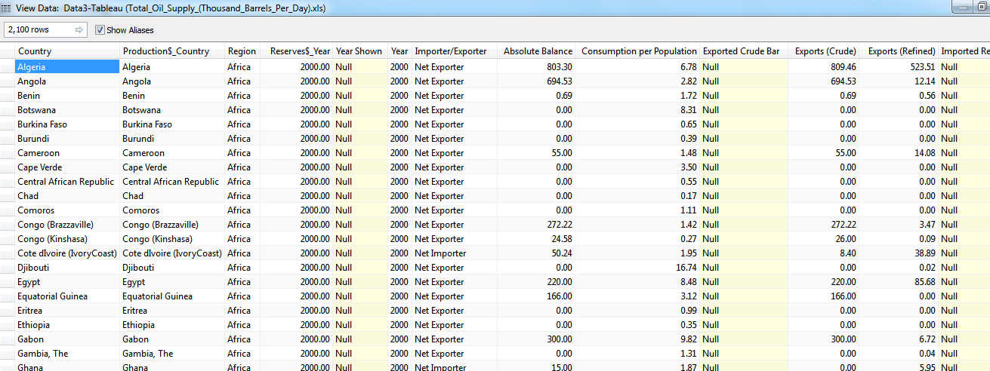
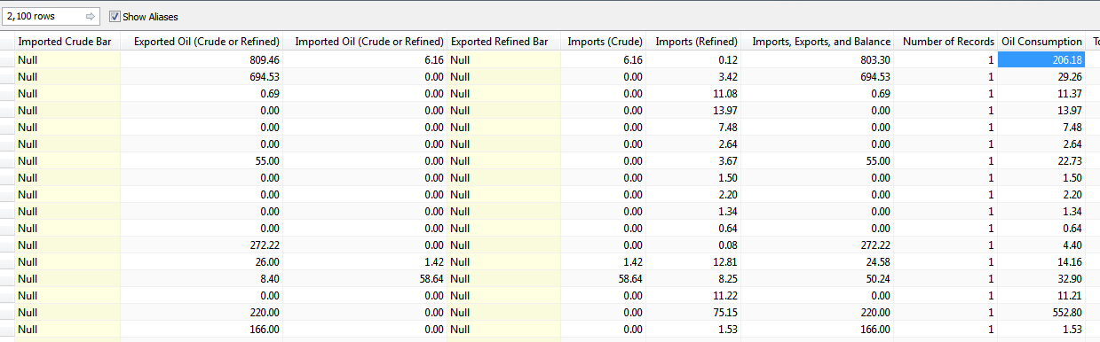
Oil Consumption Data
Introduction to Tableau

Slide 5
Aim is to understand
That oil consumption data shows below details
Cure Oil, refined oil imports and Exports by country also weighted by population
Reserves left by country and by region
Consumption by population over the time
Really??? Is it easy to get the picture?

Slide 6
What is Tableau
Tableau is a rapid BI software
Great visualizations: Allows anyone to connect to data, visualize and create interactive, sharable dashboards in a few clicks
Ease of use: It's easy enough that any Excel user can learn it, but powerful enough to satisfy even the most complex analytical problems.
Fast: We can create parallelized dashboards, quick filters and calculations

Slide 7
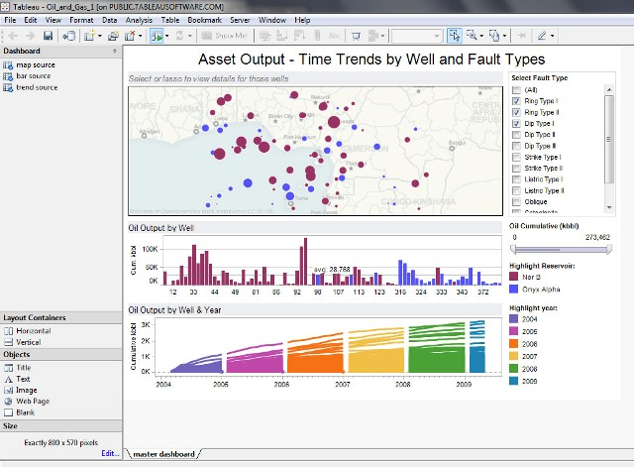
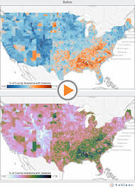
Sample Tableau dashboards

Slide 8
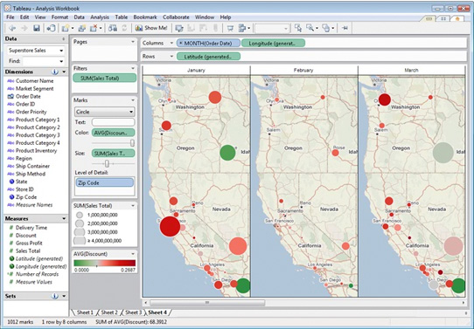
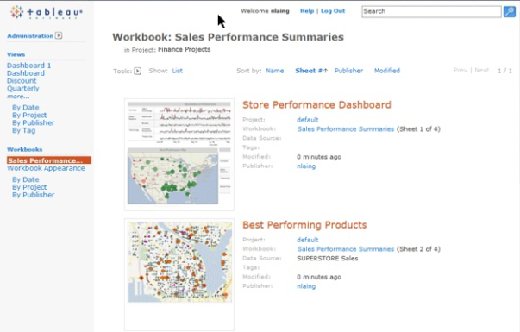
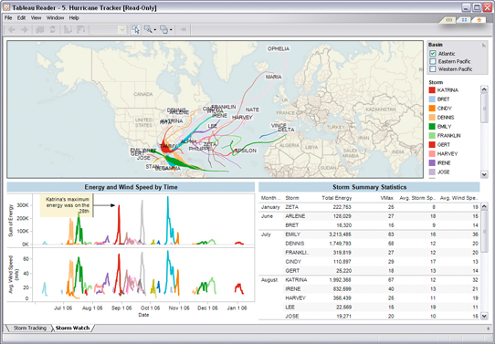
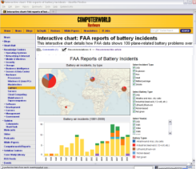
Tableau Products – Add Tableau Online also
Tableau Desktop
Create
Tableau Server
Share - Web
Tableau Reader
Share - Local
Tableau Public
Share - Everyone
ad hoc analytics, dashboards, reports, graphs
explore, visualize, and analyze your data
create dashboards to consolidate multiple views
deliver interactive data experiences
business intelligence solution scales to organizations of all sizes
share visual analytics with anyone with a web browser
publish interactive analytics or dashboards
secure information and manage metadata
collaborate with others
share visualizations & dashboards on the desktop
filter, sort, and page through the views
“Acrobat for Data”
free download
create and publish interactive visualizations and dashboards
embed in websites and blogs
free download and free hosting service

Slide 9
Steps to create the Tableau Dashboard
Create data source in SQL/Excel/CSV etc format.
Prepare all the columns(Add this in best practises in Tableau)
Create a connection from Tableau to data source
Create sheets by using features of Tableau for additional fields/functionalities
Put all these sheets in the dashboard
Improve the visual appeal of the dashboard

Slide 10
Types of Connections
Extract Connection: A connection with a static database, which is refreshed every day/hour/period. All data is copied from the data source to Tableau Server. Refreshing the data source will not give you the latest data - you have to refresh the extract to get these.
Live Connection: This will query the underlying data in the data source/database - refreshing the visualisation will give you the latest results. No data is copied to Tableau Server for pre-processing.

Slide 11
Types of Connections
Which is better?
Extract will be better when -
Underlying data source is unacceptably slow.
You need to optimize your calculations and features. - http://www.tableau.com/about/blog/2014/7/understanding-tableau-data-extracts-part1
You need to be offline
You need a portable dashboard – sharing and collaborations become easy.
Live will be better when –
When you have a fast database
When you need up-to-the minute data(Real Time Updates)
When data size is huge.

Slide 12
Types of Connections – Use Cases
Use Case | Connections
Stock Data Analysis (Real Time) | Live
Seller Dashboard (Refresh at EOD) Flipkart | Extract (Refresh)
Digital Data (File/Data Source Size Huge) | Live
Static Data Source (Campaign Results – Refresh quarterly) | Extract

Slide 13
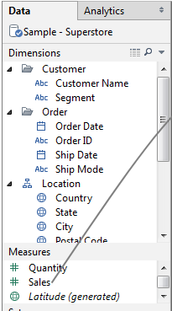
Dimensions vs Measures
Dimensions are those columns in the data source which contain discrete categorical information .
Measures are those columns in the data source which contain quantitative, numerical information (that is, fields where the values are numbers).

Slide 14
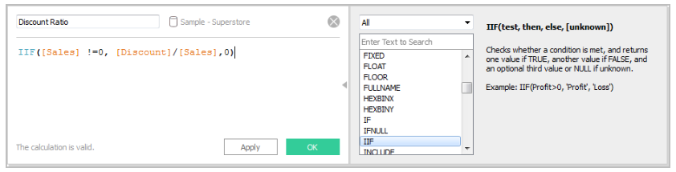
Calculated Fields
To extract meaningful results from your data, it is sometimes necessary to modify the fields that Tableau extracts from your data source.
Tableau provides a calculation editor for customizing and creating fields, and also supports ad-hoc calculations that you create on shelves as you work in a view.

Slide 15
Filters
There are 3 filters –
Normal Filters
Action Filters
Context Filters

Slide 16
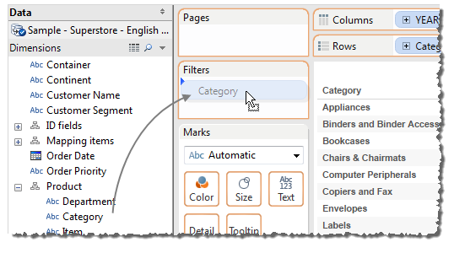
Filters – Normal Filters
Use for filtering data by using measure/dimension.

Slide 17
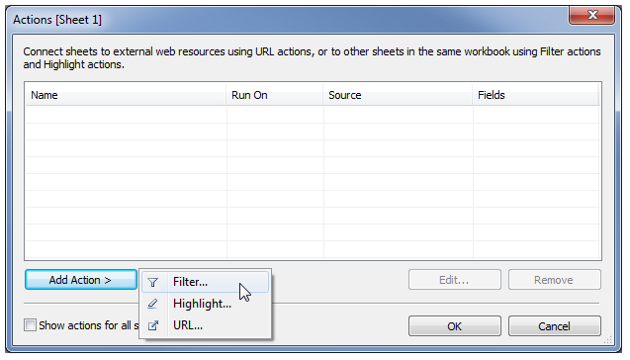
Filters – Action Filters
Use for drill-down filtering across sheets.

Slide 18
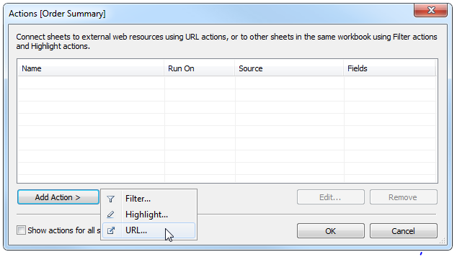
Filters – URL Filters
A URL action is a hyperlink that points to a Web page, file, or other web-based resource outside of Tableau. You can use URL actions to link to more information about your data that may be hosted outside of your data source. To make the link relevant to your data, you can substitute field values of a selection into the URL as parameters.

Slide 19
Filters – Context Filters
By default, all filters that you set in Tableau are computed independently. That is, each filter accesses all rows in your data source without regard to other filters. However, you can set one or more categorical filters as context filters for the view.
You can think of a context filter as being an independent filter. Any other filters that you set are defined as dependent filters because they process only the data that passes through the context filter.
You may create a context filter to:
  Improve performance – If you set a lot of filters or have a large data source, the queries can be slow. You can set one or more context filters to improve performance.
  Create a dependent numerical or top N filter – You can set a context filter to include only the data of interest, and then set a numerical or a top N filter.

Slide 20
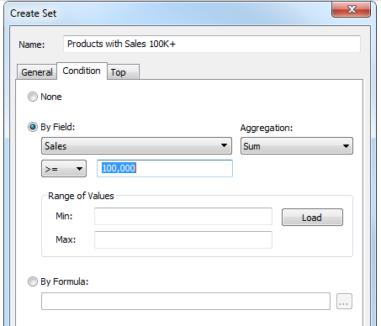
Sets
Sets are custom fields that define a subset of data based on some conditions. A set can be based on a computed condition, for example, a set may contain customers with sales over a certain threshold.

Slide 21
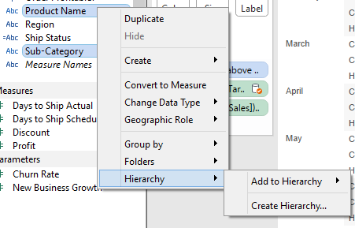
Grouping/Hierarchy
A group is a combination of dimension members that make higher level categories. For example, if you are working with a view that shows average test scores by major, you may want to group certain majors together to create major categories. English and History may be combined into a group called Liberal Arts while Biology and Physics may be grouped as Science Majors.

Slide 22
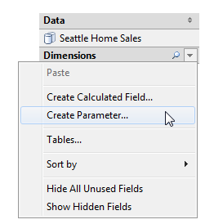
Parameters
Parameters are dynamic values that can replace constant values in calculations, filters, and reference lines. For example, you may create a calculated field that returns true if Sales is greater than $500,000 and otherwise return false. You can replace the constant value of “500000” in the formula with a parameter. Then using the parameter control you can dynamically change the threshold in your calculation.

Slide 23
Windows Functions/Table Calculations
Important things to understand –
Addressing and Partitioning
Common Windows Function – Windows_Max(), Windows_Sum()

Slide 24
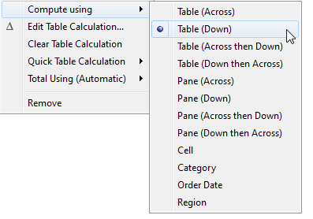
Addressing and Partitioning
Table calculations are performed on a single measure in the view.
The dimensions that define the part of the table you are applying the calculation to (computing along) are called addressing fields, and the dimensions that define how to group the calculation are called partitioning fields.
In the example of a running sum of product sales across several years, the addressing field is the Date field, and the partitioning field is the product field.

Slide 25
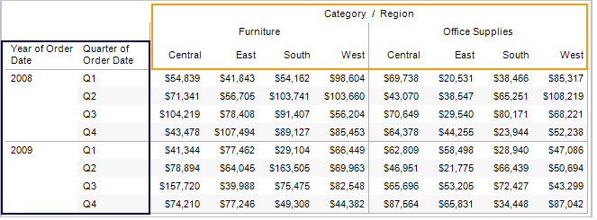
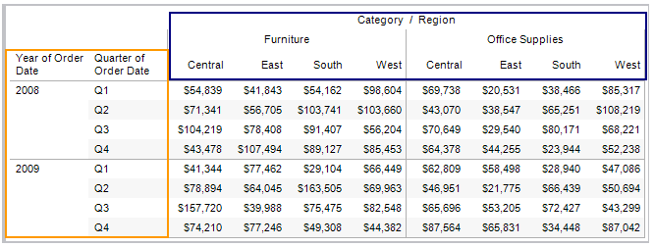
Common Addressing and Partitioning
Table (Across) –
Table (Down) -

Slide 26
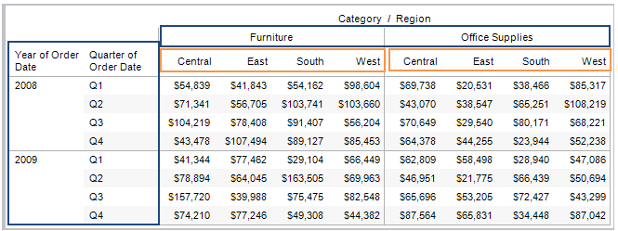
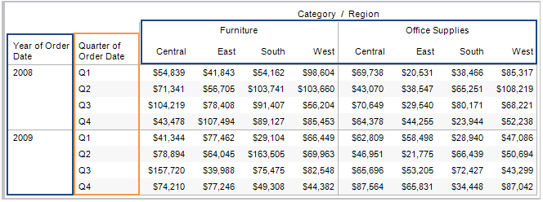
Common Addressing and Partitioning
Pane (Across) -
Pane (Down) -

Slide 27
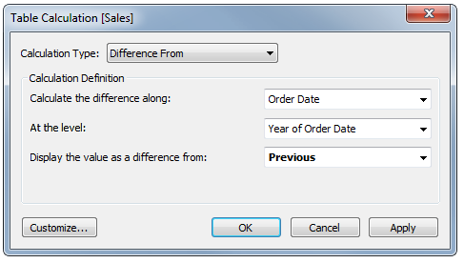
Common Table Calculations
Difference From - Use this type of calculation to compute the difference between two specified values in the table along a certain dimension. For example, compute the difference between 2006 and 2007 quarterly sales for four different customer segments.
Running Total
Percent Difference
Percent of Total

Slide 28
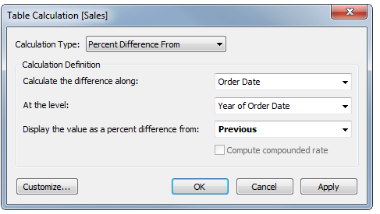
Common Table Calculations
Percent Difference - Use this type of calculation to display the rate of change between two specified values in the table by computing the difference as a percentage. A common use of this type of calculation is to compute the percent gain year over year (CAGR).
Running Total
Percent Difference
Percent of Total

Slide 29
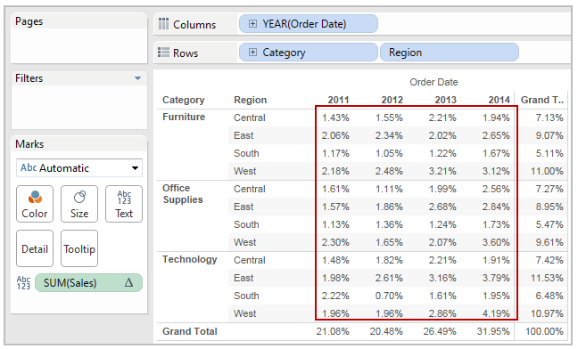
Common Table Calculations
Percent of Total - When you select Percentage of Table, each measure on the worksheet is expressed as a percentage of the total for the entire worksheet (table). For example, Technology in the East region accounts for 3.79% of total sales in 2014. The grand totals for rows show that 2014 accounts for 31.95% of the total sales. Summing the grand totals for rows or for columns yields 100% of the total.

Slide 30
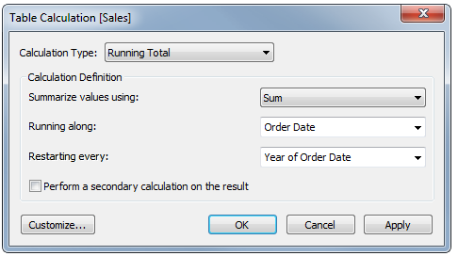
Common Table Calculations
Running Total - Use the Running Total calculation to compute a cumulative total across a dimension or table structure. For example, you can use this type of calculation to calculate the cumulative sales for each quarter for several years.

Slide 31
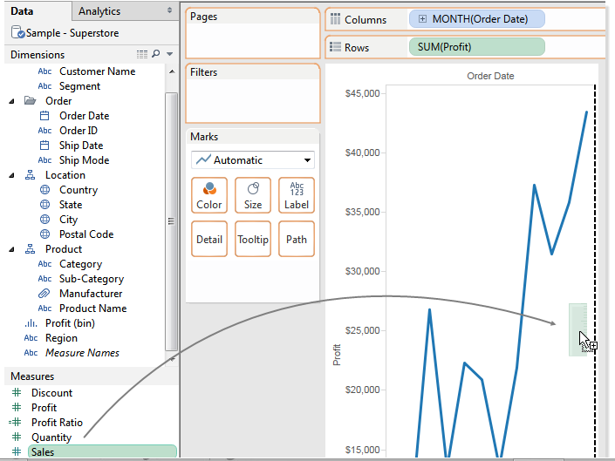
Dual Axis
You can compare multiple measures using dual axes, which are two independent axes that are layered on top of each other.
The Synchronize Axis option ensures that you make a scaled and correct comparison. However, sometimes this option may not be available (grayed out). This is because the data type of one of the axes is different from the other.

Slide 32
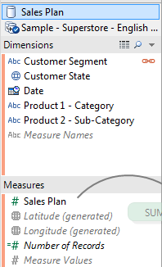
Data Blending
Data blending is when you combine data from multiple data source types in a single worksheet. The data is joined on common dimensions.
Data Blending does not create row level joins and is not a way to add new dimensions or rows to your data.
For example, you may have Sales data collected in an Oracle database and Sales Goal data in an Excel spreadsheet. To compare actual sales to target sales, you can blend the data based on common dimensions to get access to the Sales Goal measure.

Slide 33
Tableau Server
Which is better?
Extract will be better when -
Underlying data source is unacceptably slow.
You need to optimize your calculations and features. - http://www.tableau.com/about/blog/2014/7/understanding-tableau-data-extracts-part1
You need to be offline
You need a portable dashboard – sharing and collaborations become easy.
Live will be better when –
When you have a fast database
When you need up-to-the minute data(Real Time Updates)
When data size is huge.

Slide 34
Demo
Which is better?
Extract will be better when -
Underlying data source is unacceptably slow.
You need to optimize your calculations and features. - http://www.tableau.com/about/blog/2014/7/understanding-tableau-data-extracts-part1
You need to be offline
You need a portable dashboard – sharing and collaborations become easy.
Live will be better when –
When you have a fast database
When you need up-to-the minute data(Real Time Updates)
When data size is huge.

